Slide 1

Cyberbullying and Fake Account Detection in Social Media
Project Mentor : Richard Joseph
Group Number : 48
Group Members : (D17A)
Jayesh Samtani 57
Sagar Sidhwa 62
Somesh Tiwari 71
Riya Wadhwani 74

Slide 2
Content
1. Introduction
2. Lacuna in the existing systems
3. Problem Definition along with sub goals
4. Literature Survey
5. Methodology employed
6. Hardware , Software , tools and the constraints
7. Block / Modular diagram
8. Conclusion
9. References

Slide 3
Introduction to Project
Cyber Crime and Bullying have increased on Social Networking sites with having more than 50 Crores active users until now, so the misuse of the Online Social Platform had taken place in several times for e.g Bullying Someone by sending the harmful messages ,spreading of the harassment messages by using the fake accounts, using the abusive words on the social media etc
In a recent report it was found that nearly 25% of People, especially teens and young adults are finding new ways to bully one another over the Internet and parents don’t know that their child has been involved in a cyberbullying incident.
A Preventive measure to STOP the above crimes caused a need for different Machine Learning algorithms for detection of the Cyber Crime and Bullying and the fake accounts so as to report these issues to the system immediately and to stop the crimes to increase in future and develop a secure online environment.

Slide 4
Lacuna in the existing system
Lacuna in the existing systems / Comparison with existing systems :
Lack of Security
No Transparency
Only one algorithm is Implemented
Costly to produce reports

Slide 5
Problem Definition
Nowadays, cybercrime is one of the common issues everyone is facing and it is impacting the people, in which some are long period of sadness, anger, irritability, loss of interest in activities, being restless, anxious and worried, even in some cases they go into depression and take steps to scarify their life.It is unfortunate that there are no special Anti-Cyberbullying Laws in India yet.There are some common types of cyberbullying that is Flaming, Harassment, Denigration,Impersonation,Trickery. So to detect cyberbullying we have to make some software that will detect it and then report it to www.cybercrime.gov.in. Similarly, we will detect fake accounts.

Slide 6
Literature Survey
1. Title - Cyberbullying: A Review of the Literature
Authors- Charles E. Notar* , Sharon Padgett, Jessica Roden
Year - 2013
2. Title - Cyberbullying : a literature review
Authors-University of Northern Iowa
Year - 2010
3. Title - Bullying and Cyberbullying: History, Statistics, Law, Prevention and Analysis
Authors- Richard Donegan
Year - 2012
4. Title - Detection of Fake Profiles in Social Media
Authors- Aleksei Romanov, Alexander Semenov, Oleksiy Mazhelis and Jari Veijalainen
Year - 2017
5. Title-Detecting Clusters of Fake Accounts in Online Social Networks
Authors-C. Xiao, D. M. Freeman and T. Hwa
Year - 2015

Slide 7
Methodology Employed
The proposed approach contains three main steps namely Preprocessing, features extraction and classification step.
In the preprocessing step we clean the data by removing the noise and unnecessary text.
The preprocessing step is done in the following: -
Tokenization
Lowering text
Stop words and encoding cleaning
The second step of the proposed Model is the features extraction step. In this step the textual data is transformed into a suitable format applicable to feed into machine learning algorithms.
The last step in the proposed approach is the classification step where the extracted features are fed into a classification algorithm to train, and test the classifier and hence use it in the prediction phase. We will use classifiers, namely, SVM (Support Vector Machine), Naive Bayes,Random Forest,Decision Tree , Logistic Regression and Neural Network.

Slide 8
Methodology Employed
Accuracy of different algorithms will be Compared to get the best possible result.
For the fake profile detection this paper proposes the detection process starts with the selection of the profile that needs to be tested. After selection of the profile the suitable attributes ie., features are selected on which the classification algorithm is being implemented ,the attributes extracted are passed to the trained classifier.
Different Classifier algorithms such as Gradient Booster, random forest Decision trees ,Support Vector Machine and Neural Networks such as RNN and CNN can be used.
Effectiveness of the proposed method is accomplished by machine learning methods. Here cross-validation technique, and the basic metrics and evaluation of the classifier performance will be used.

Slide 9
Hardware, Software, Tools & Constraint
Software & Hardware Used :
Intel Pentium Processor
RAM>=4GB
Anaconda
Visual Studio
Tools :
Django
Machine Learning Algorithms
Python Libraries
Windows 10 SDK
Constraints :
Continuous network connectivity required
Process or requirement varies according to the Dataset

Slide 10
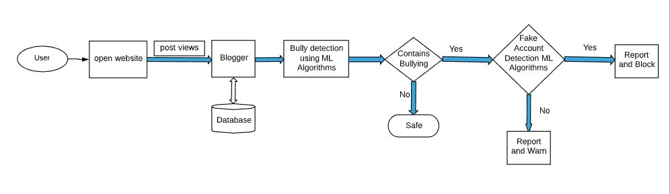
Block Diagram of the Project

Slide 11
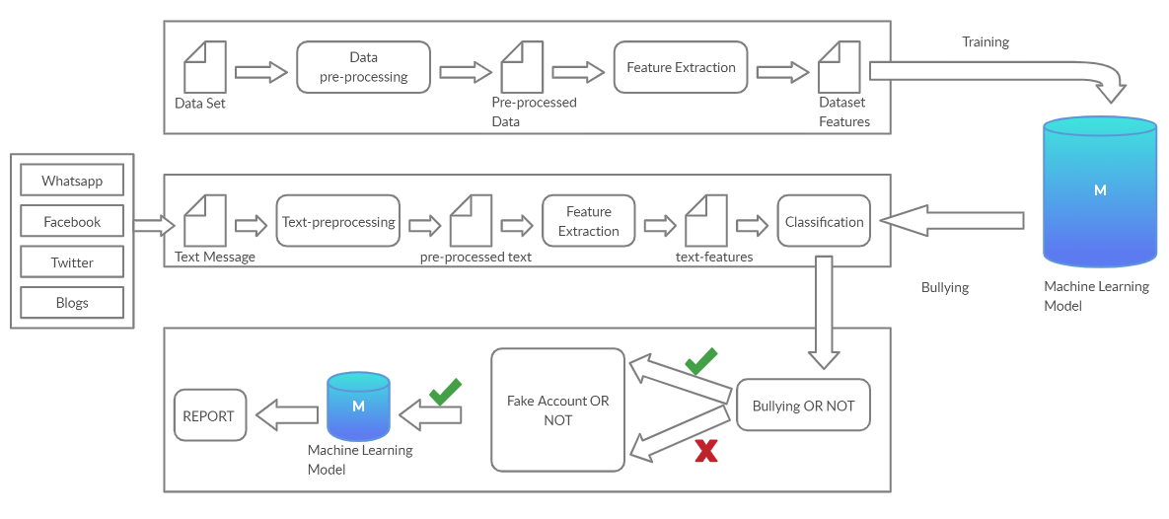
Modular Diagram of the Project

Slide 12
Implementation Details
Step 1 : Preprocessing of the datasets and finding the minimum set of attributes from two datasets i.e from Cyberbullying and the fake account
Step 2 : Seperation of the attributes that will actually used to identify these bullying, contains abusive words, contains fake names,emails etc and save them the dataset for further processing.
Step 3: Applying Machine Learning Models like Support Vector Machine Classifier, Random Forest algorithm,Naïve Bayes, Logistic Regression, K-mean clustering,ADT and BFT tree and Neural Networks etc on the datasets of Cyberbullying and the fake account.
Step 4 : Testing the messages that are extracted from the chats or the tweets or the blog which is posted on sites that can cause bullying or use of abusive words and then sending the words to different Machine Learning models
Step 5 : Finding the best algorithm which best suits or fit for our system to achieve the highest accuracy.
Step 6 : Finally if any Cyber Crime or Bullying found that was going on then a warning Message is generated for that account and the reporting of the same will be carried out to the Cyber Department

Slide 13
Conclusion
In this project, we proposed an approach to detect Cyberbullying and Fake Account Detection using machine learning techniques.
We will evaluate our model on Different ML Algorithms and we will also use TFIDF for features extraction By using machine learning algorithms to its full extent.
We will eliminate the need for manual prediction of a fake account, which needs a lot of human resources and is also a time-consuming process.

Slide 14
References
S. Gurajala, J. S. White, B. Hudson, and J. N. Matthews, “Fake Twitter accounts: Profile characteristics obtained using an activity-based pattern detection approach,” in Proceedings of the 2015 International Conference on Social Media & Society , Toronto, Ontario, Canada, 2015.View at: Publisher Site | Google Scholar.
N. V. Chawla, K. W. Bowyer, L. O. Hall, and W. P. Kegelmeyer, “SMOTE: synthetic minority over-sampling technique,” Journal of Artificial Intelligence Research, vol. 16, pp. 321–357, 2002.View at: Google Scholar
I. Jolliffe, Principal Component Analysis, 2002.View at: MathSciNet.
S. Sperandei, “Understanding logistic regression analysis,” Biochemia Medica, vol. 24, no. 1, pp. 12–18, 2014.View at: Publisher Site | Google Scholar.

